Slide 1
Data Visualization
J.P. Tonde

Slide 2
Data Visualization
Data visualization is the process of representing data using visuals to help people understand patterns, trends, and insights quickly.
Inshort
Data visualization turns data into pictures, so people can understand it at a glance.

Slide 3
EDA VS Data Visualization
Point | EDA | Data Visualization
Goal | To explore and understand data | To explain and present data
Focus | Finding patterns, errors, relations | Sharing results and insights
Used by | Data analyst or researcher | Decision-maker or audience
Output | Cleaned data, patterns | Graphs, charts, dashboards
Example Tool | Python (Pandas, Seaborn) | Tableau, Power BI, Excel
Foundation of Data Science

Slide 4
Applications of EDA
Maximize insight into a dataset.
Know its underlying dataset.
Detect outliers and anomalies.
Test Underlying assumptions.
Check for missing data and other mistakes
Univariate Bivariate and Multivariate analysis (Using as Pie Chart, Count Plot, Box Plot, Scatter Plot, Heat Map)
Plotting raw data

Slide 5
Visual Encoding

Slide 6
Visual Encoding
Visual encoding means how data is represented visually using shapes, colors, sizes, or positions in a chart or graph.
It is the process of transforming data values into visual elements so people can easily understand the information.
Or
Visual encoding is the way we convert data into visuals — like using color, position, size, or shape — to represent information clearly.
Types of Visual Encoding
Planar: Planar encoding is a simple as drawing graphs across X and Y axis. Planar variables are suitable to present any quantitative data. (Use to represent 2 variables)
Retinal: Human beings are very sensitive to the retinal variable such as color, shape, size, orientation and other kind of properties. (Use to represent more than two variables)
Foundation of Data Science

Slide 7
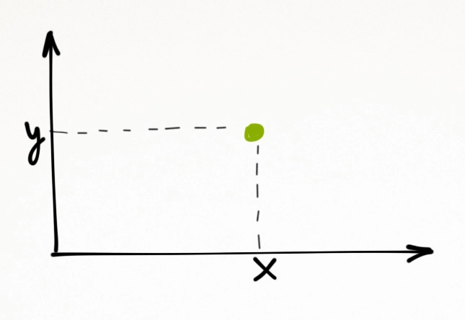
Planar Variable
So what should we do then to present three or more variables? We can use the retinal variables!
Foundation of Data Science

Slide 8

Size:
We know that size is important. You can see the difference right away. Small is innocuous, large is dangerous perhaps. Size is a good visualizer for the quantitative data.
So what should we do then to present three or more variables? We can use the retinal variables!
Foundation of Data Science

Slide 9
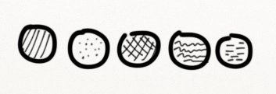
Texture
Texture is less common. You can’t touch it on screen, and it’s usually less catchy than color. So, in theory texture can be used for soft encoding, but in practice it’s better to pass on it.
Foundation of Data Science

Slide 10

Shape
Round circles ○, edgy stars ☆, solid rectangles █. We can easily distinguish dozens of shapes. They do work well sometimes for the visual encoding of categories.
Foundation of Data Science

Slide 11

Orientation
Orientation is tricky.
While we’re able to clearly identify vertical vs. horizontal lines, it is harder to use it properly for visual encoding.
Foundation of Data Science

Slide 12

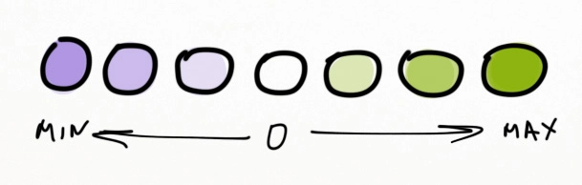
Color Value
Any color value can be moved over a scale. Greyscale is a good example. While we can’t be certain that#999 color is lighter than #888, still it’s a helpful technique to visualize the ordered data
Foundation of Data Science

Slide 13
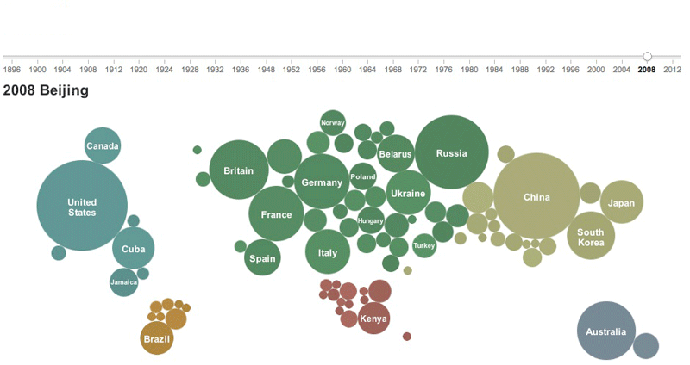
That’s how the world map can be used to visualize the medal counts. Very smart. There are names for nations with many medals, all the rest can be identified by their geographic position (everybody knows where New Zealand)
Visual encoding variables:
Color: continent
Size: medals count
X and Y: the world map
Foundation of Data Science

Slide 14
Visual encoding in data visualization refers to the method of representing data values through visual elements such as position, color, shape, size, and orientation. The goal is to translate data into a format that is easy to interpret and analyze visually. Here’s an overview of common visual encoding techniques with examples:
1. Position
Example: In a scatter plot, data points are positioned based on their values on the x-axis and y-axis. For instance, a scatter plot showing the relationship between height and weight uses position to represent the height on one axis and weight on the other.
2. Length
Example: Bar charts use length to represent data values. For instance, a bar chart displaying monthly sales figures uses the length of each bar to indicate the sales amount, with longer bars representing higher sales.
3. Area
Example: Bubble charts use the area of circles to represent data values. For example, a bubble chart might use the area of each bubble to represent the market share of different companies, with larger bubbles indicating a larger market share.

Slide 15
4. Angle
Example: In pie charts, angles of slices represent proportions of a whole. For instance, a pie chart showing the market share of different products uses the angle of each slice to show each product’s percentage of the total market.
5. Color
Example: Heat maps use color to represent data values. For example, a heat map showing the number of website visitors by time of day uses varying colors to indicate the number of visitors, with warmer colors (like red) representing higher numbers and cooler colors (like blue) representing lower numbers.
6. Shape
Example: In a scatter plot, different shapes can represent different categories. For example, a scatter plot showing the performance of students in various subjects might use circles for math scores and squares for science scores.
7. Texture
Example: In some charts, different textures or patterns can differentiate between data sets. For example, a bar chart might use solid bars for one year’s data and striped bars for another year’s data to visually distinguish between the two.

Slide 16
8. Size
Example: In a bubble chart, the size of each bubble can represent an additional variable, such as the population of different cities. Larger bubbles would represent larger populations.
9. Orientation
Example: In a bar chart, horizontal vs. vertical bars can indicate different types of data or emphasis. For instance, a vertical bar chart might be used to show time-based data, while a horizontal bar chart might be used to show categorical data.
10. Line Style
Example: In line charts, different line styles (solid, dashed, dotted) can represent different data series. For example, a line chart tracking the performance of various stocks might use solid lines for one stock, dashed lines for another, and dotted lines for a third.

Slide 17
Role of Data visualization and its corresponding visualization tool
Data visualization is the graphical representation of information and data. By using visual elements like charts, graphs, maps, and dashboards, visualization tools make data more accessible, understandable, and actionable.
It helps in:
Exploring data to find trends, anomalies, and insights.
Communicating information clearly to both technical and non-technical audiences.
Supporting decision-making by transforming raw data into meaningful visuals.
Foundation of Data Science

Slide 18
1. Distribution
Shows how data values are spread across a range. It helps in identifying frequency, spread, and outliers.
Purpose: Understand the spread and central tendency of data.
Common charts: Histogram, Box Plot, Violin Plot, Density Plot.
Example: Visualizing exam scores of students to see performance patterns.
2. Relationship
Depicts how two or more variables relate to each other — showing correlation or dependency.
Purpose: Identify positive, negative, or no relationships between variables.
Common charts: Scatter Plot, Bubble Chart, Pair Plot, Heatmap.
Example: Plotting “Hours Studied vs Marks Scored” to see if studying more increases performance.
Foundation of Data Science

Slide 19
Comparison
Used to compare categories, groups, or time periods to observe similarities and differences.
Purpose: Show how values differ across groups or over time.
Common charts: Bar Chart, Column Chart, Line Chart, Grouped Bar Chart.
Example: Comparing monthly sales of different products or yearly revenue growth.
Composition
Displays how individual parts make up a whole and their relative proportions.
Purpose: Understand contribution of each component to the total.
Common charts: Pie Chart, Stacked Bar/Area Chart, Treemap, Donut Chart.
Example: Visualizing percentage of students in different departments or share of market products.
Foundation of Data Science

Slide 20
Location
Used to show spatial data or geographical patterns.
Purpose: Visualize data distribution across physical or geographical regions.
Common charts: Map, Heatmap, Choropleth Map, Symbol Map.
Example: Displaying COVID-19 cases across states or customer density by city.
Connection
Shows links or networks between entities — often used to visualize relationships in social, technical, or organizational structures.
Purpose: Understand interconnections or data flow.
Common charts: Network Diagram, Sankey Diagram, Node-Link Diagram.
Example: Visualizing website navigation paths or social media user connections.
Foundation of Data Science

